Slide 1
A Naïve Bayes Computational Model of Categorisation
Courtney Ford

Slide 2
What is a Naïve Bayes model?
Bayes’ Theorem represents a way of calculating the probability, using statistics, of an event occurring based on previously learned information about that event.
The Naïve Bayes model is based on this theorem, however, it assumes that all features of an item (or disease) are independently related, and therefore independently contribute to the probability that the presence of feature X would be categorized as a representation of disease Y. A collection of features are therefore calculated independently before adding the probabilities together to form the total probability that a series of features together represent an item.

Slide 3
Why choose a Naïve Bayes model?
I chose to use a Naïve Bayes model as I feel that it captures humans’ natural ability to subconsciously calculate the probability that a given feature is representative of an item based on the frequency of that feature in training information.
Though this theory assumes that humans are fairly rational in their categorization of features to items, I believe that humans are capable of performing mental probability calculations –perhaps without the awareness of the individual– to form associations between recurrent items and features.
Importantly, the Naïve Bayes model’s treatment of each individual feature as a separate contributor to the classification of items means that highly recurrent features will impact the overall probability that the presence of that feature, regardless of the other features seen with it, will be categorized into the associated item. This gives recurrent features a higher weight, which I feel is accurate of how humans would treat such data.

Slide 4
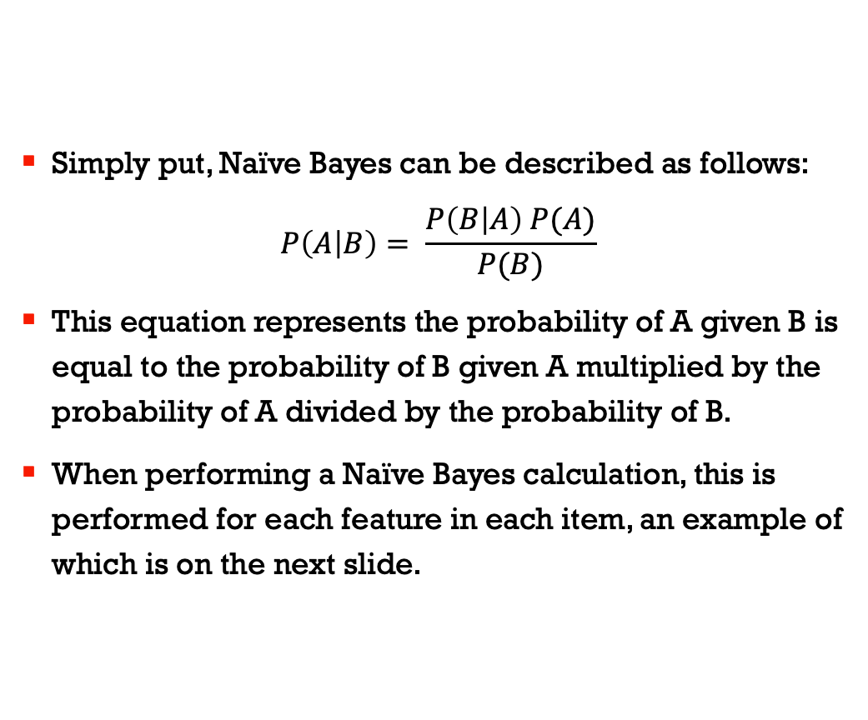
What is the Naïve Bayes formula?
Simply put, Naïve Bayes can be described as follows:
$$P\left(A | B\right)= \frac{P\left(B | A\right) P(A)}{P(B)}$$
This equation represents the probability of A given B is equal to the probability of B given A multiplied by the probability of A divided by the probability of B.
When performing a Naïve Bayes calculation, this is performed for each feature in each item, an example of which is on the next slide.

Slide 5
Naïve Bayes formula, continued.
Frequency Table - Category A, Dim 1 |  |  |  | Likelihood Table - Category A, Dim 1
Dimension | Yes | No |  | Dimension | Yes | No
A | 4 | 0 |  | A | 4 | 0 | 0.25
C | 0 | 5 |  | C | 0 | 5 | 0.3125
X | 1 | 2 |  | X | 1 | 2 | 0.1875
Y | 1 | 1 |  | Y | 1 | 1 | 0.125
Z | 0 | 2 |  | Z | 0 | 2 | 0.125
Grand Total | 6 | 10 |  | Grand Total | 6 | 10
 |  |  |  |  | 0.375 | 0.625
Participants will categorise as Category A if they see symptom A in dimension 1
P (Yes | A) = P (A | Yes) * P(Yes) / P (A)
P (A | Yes) = 4/6 = .67, P(A) = 4/16 = .25, P(Yes) = 6/16 = .38
P (Yes | A) = .67 *.38 / .25 = 1.02
Participants will categorise as Category A if they see symptom X in dimension 1
P (Yes | X) = P (X | Yes) * P(Yes) / P (X)
P (X | Yes) = 1/6 = .17, P(X) = 3/16 = .19, P(Yes) = 6/16 = .38
P (Yes | X) = .17 * .38 / .19 = 0.34
Participants will categorise as Category A if they see symptom Y in dimension 1
P (Yes | Y) = P (Y | Yes) * P(Yes) / P (Y)
P (Y | Yes) = 1/6 = .17, P(Y) = 2/16 = .13, P(Yes) = 6/16 = .38
P (Yes | Y) = .17 * .38 / .13 = 0.5

Slide 6
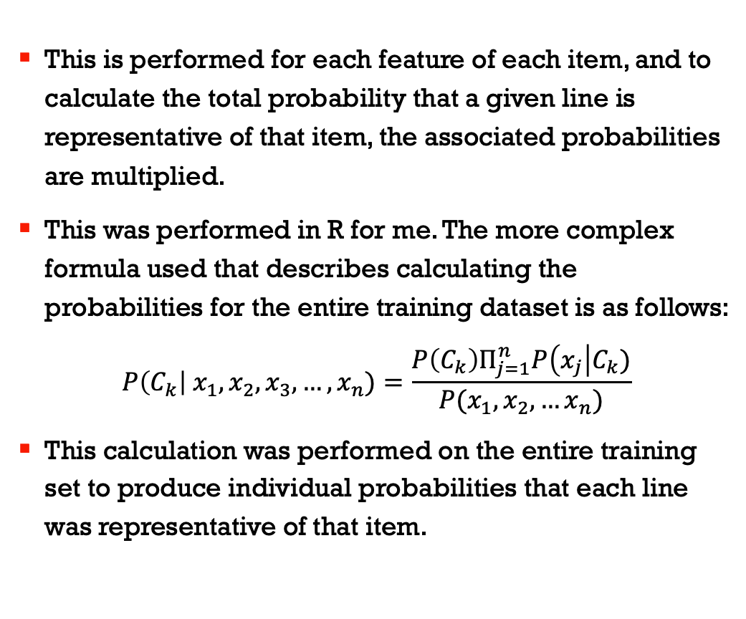
Naïve Bayes formula, continued.
This is performed for each feature of each item, and to calculate the total probability that a given line is representative of that item, the associated probabilities are multiplied.
This was performed in R for me. The more complex formula used that describes calculating the probabilities for the entire training dataset is as follows:
$$P\left(C_{k}\right| x_{1}, x_{2}, x_{3},…, x_{n})=\frac{P\left(C_{k}\right)Π_{j=1}^{n}P\left(x_{j}\right|C_{k})}{P(x_{1}, x_{2},…x_{n})}$$
This calculation was performed on the entire training set to produce individual probabilities that each line was representative of that item.

Slide 7
Calculating the constituent items
To calculate the probability of the constituent items, R used the previously calculated probabilities of each training line to then generate the total probability that the test line could be categorized as a given item.
Test Item | Test item features |  |  | Probability that the test item would be categorised in each Category |  |  | Probability for category rounded to the third decimal place
 | Dim.1 | Dim.2 | Dim.3 | Category.A | Category.B | Category.C
1 | A | B | Y | 0.999100809 | 0.357142857 | 4.17E-06 | 99.910%
2 | C | Y | B | 0.000222173 | 0.005524862 | 0.996412914 | 0.022%
3 | Y | A | C | 0.510204082 | 0.000832639 | 0.02173913 | 51.020%
4 | X | B | C | 0.147928994 | 0.666666667 | 0.010989011 | 14.793%
5 | X | X | B | 0.084745763 | 0.902527076 | 0.217391304 | 8.475%

Slide 8
Calculating conjunctive categories
To calculate the conjunctive categories, I added together the probabilities that the test line was representative of category X and category Y. I chose to add, because in probability calculations, whenever you are combining the probability (X “and” Y), these two values are added together.
 |  |  |  |  |  |  | Product of Probabilities for Selected Categories
1 | A | B | Y | 0.999100809 | 0.357142857 | 4.17E-06 | 35.682%
2 | C | Y | B | 0.000222173 | 0.005524862 | 0.996412914 | 0.000%
3 | Y | A | C | 0.510204082 | 0.000832639 | 0.02173913 | 0.042%
4 | X | B | C | 0.147928994 | 0.666666667 | 0.010989011 | 9.862%
5 | X | X | B | 0.084745763 | 0.902527076 | 0.217391304 | 7.649%

Slide 9
How successful was my model?
Overall, my model captured the probability that given features were characteristic of certain categories. When comparing the Naïve Bayes calculated probabilities to the real participants’ responses, high probabilities were generally associated with a high average association score, e.g.:
This was especially true for the constituent items. My model was slightly less accurate for the conjunctive categories, for example where a probability of 35% that the line would be categorized as categories A and B was given a participant average score of only 1.17
Test Item | Test item features |  |  | Probability that the test item would be categorised in each Category |  |  | Probability for category rounded to the third decimal place | Average membership score given for test item in category
 | Dim.1 | Dim.2 | Dim.3 | Category.A | Category.B | Category.C |  | (range -10 to +10)
1 | A | B | Y | 0.999100809 | 0.357142857 | 4.17E-06 | 99.910% | 6.78
2 | C | Y | B | 0.000222173 | 0.005524862 | 0.996412914 | 0.022% | -9.33

Slide 10
Final considerations
I feel that the Naïve Bayes model is an appropriate model of human categorization, as it captures recurrent features and is a powerful method of calculating the probability that sets of features are descriptive of a given category.
Though I performed some of the calculations by hand as an example, it was easy to perform the more complex calculations in R via some simple code and csv files.
I am not convinced that the Naïve Bayes model --or my treatment of adding two categories’ probabilities-– is the best way to handle conjunctive categories, and in the future would suggest approaching this in perhaps a different way.

Slide 11
References
Brownlee, J. (2018, August 31). Naive Bayes Classifier From Scratch in Python. Retrieved April 14, 2019, from https://machinelearningmastery.com/naive-bayes-classifier-scratch-python/
Khan, R. (n.d.). Naive Bayes Classifier: Theory and R example. Retrieved March 9, 2019, from https://rpubs.com/riazakhan94/naive_bayes_classifier_e1071
Understanding Naïve Bayes Classifier Using R. (2018, January 22). Retrieved April 14, 2019, from https://www.r-bloggers.com/understanding-naive-bayes-classifier-using-r/

